Slide 1


Financial ETL with Azure Data Factory, Azure Databricks, and Azure SQL
Welcome to our comprehensive guide on building a robust financial ETL pipeline using Microsoft Azure's powerful suite of tools. We'll explore how to extract, transform, and load financial data efficiently and securely.
by Rita Uzoka for Alpha Team

Slide 2




Overview of the ETL Process
Extract
Collect data from Alpha Vantage API using Azure Data Factory.
Transform
Process and clean data with Azure Databricks' advanced analytics capabilities.
Load
Store transformed data in Azure SQL Database for reporting and analysis.
Automate
Schedule and monitor the entire pipeline for continuous data processing.

Slide 3
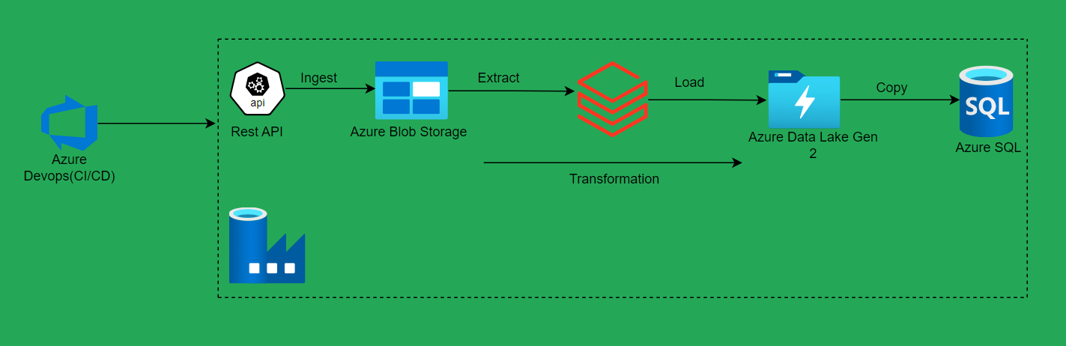
Solution Architecture
.

Slide 4
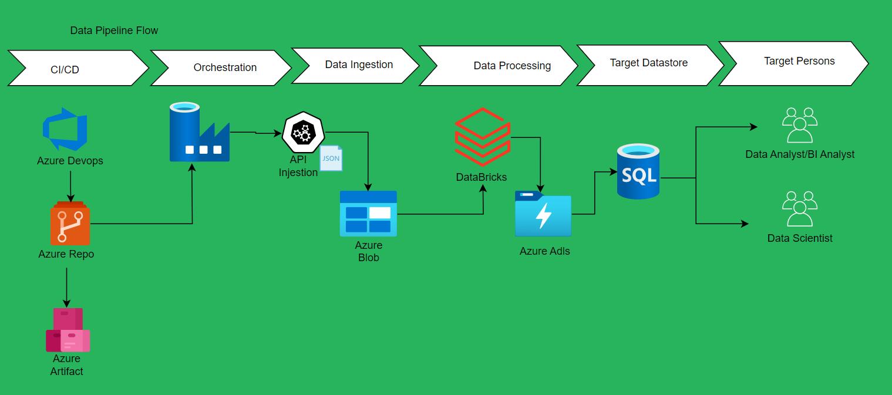
Data Pipeline Flow
.

Slide 5
Azure Services:
Provision Azure Blob Storage and SQL Database.
Configure Databricks workspace.
Set up Azure Data Factory.
Dependencies:
Configure access keys for Alpha Vantage API and Blob Storage.
GitHub Integration:
Connect Azure Data Factory to GitHub for version control. Github link here
Data Pipeline Flow
.
Setting Up the Tech Stack

Slide 6




Connecting to Data Sources with Azure Data Factory
Multiple Sources
Easy Configuration
Secure Access
Data Profiling
Connect to various financial data sources like SQL databases, APIs, and files.
Set up connections using built-in connectors and minimal coding required.
Implement data security measures with Azure Key Vault integration.
Analyze source data characteristics for better transformation planning.

Slide 7
Transforming Data Using Azure Databricks
Powerful Processing
Collaborative Environment
Leverage Apache Spark for distributed data processing at scale.
Develop and share notebooks for team collaboration on complex transformations.
Use machine learning libraries for advanced financial analytics and predictions.
Version control your data transformation code with Git integration.

Slide 8

Loading Data into Azure SQL Database
1
Prepare Target Schema
2
Configure Load Strategy
Design efficient table structures optimized for financial reporting and querying.
Choose between incremental loads or full refreshes based on data requirements.
3
Implement Data Quality Checks
4
Optimize Performance
Ensure data integrity with built-in validation rules and constraints.
Fine-tune indexing and partitioning for faster data access and analysis.

Slide 9
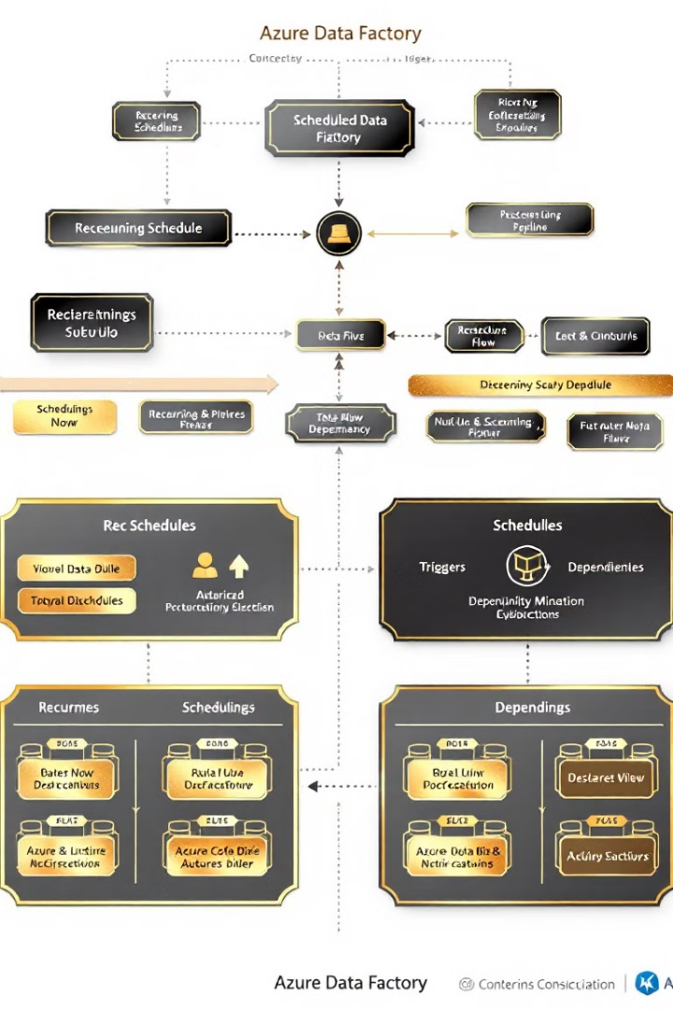
Scheduling and Automating the ETL Pipeline
1
Define Trigger
Set up time-based or event-driven triggers for pipeline execution.
2
Configure Dependencies
Establish proper sequencing of ETL tasks for data consistency.
3
Implement Error Handling
Design robust error handling and retry mechanisms for reliability.
4
Enable Notifications
Set up alerts for successful completions and potential issues.

Slide 10
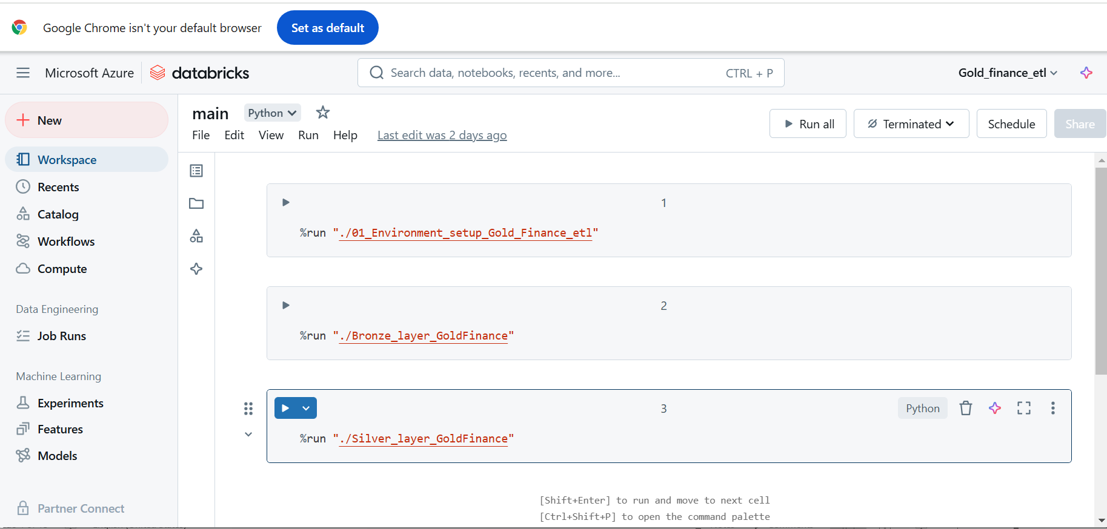
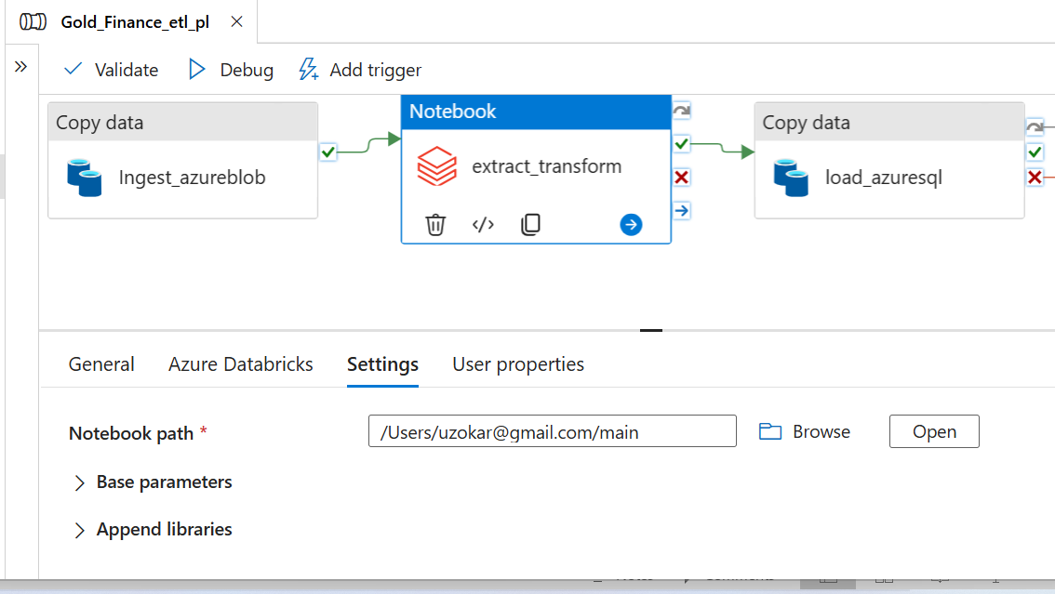
Modularized Coding in Azure Databricks
.

Slide 11
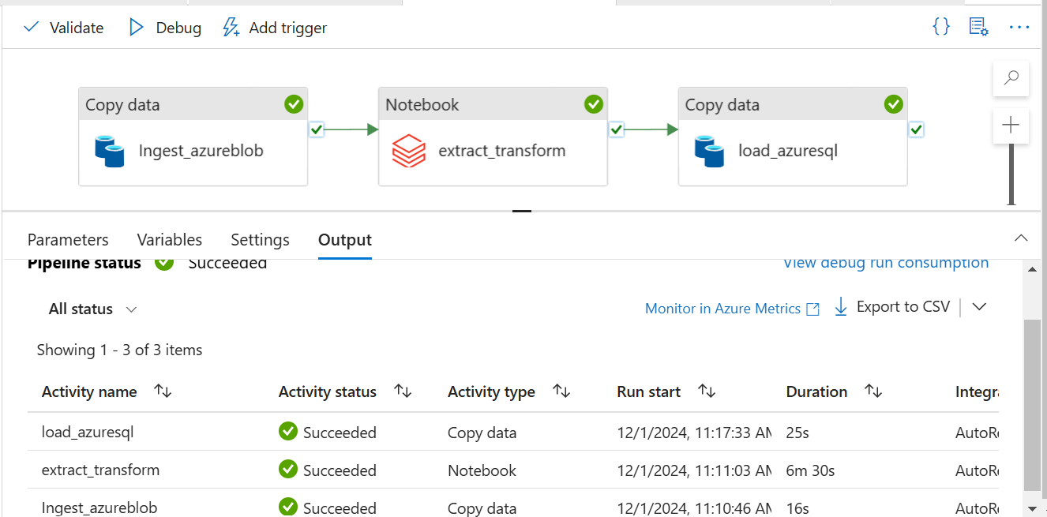
ADF Pipeline: Complete process
.

Slide 12
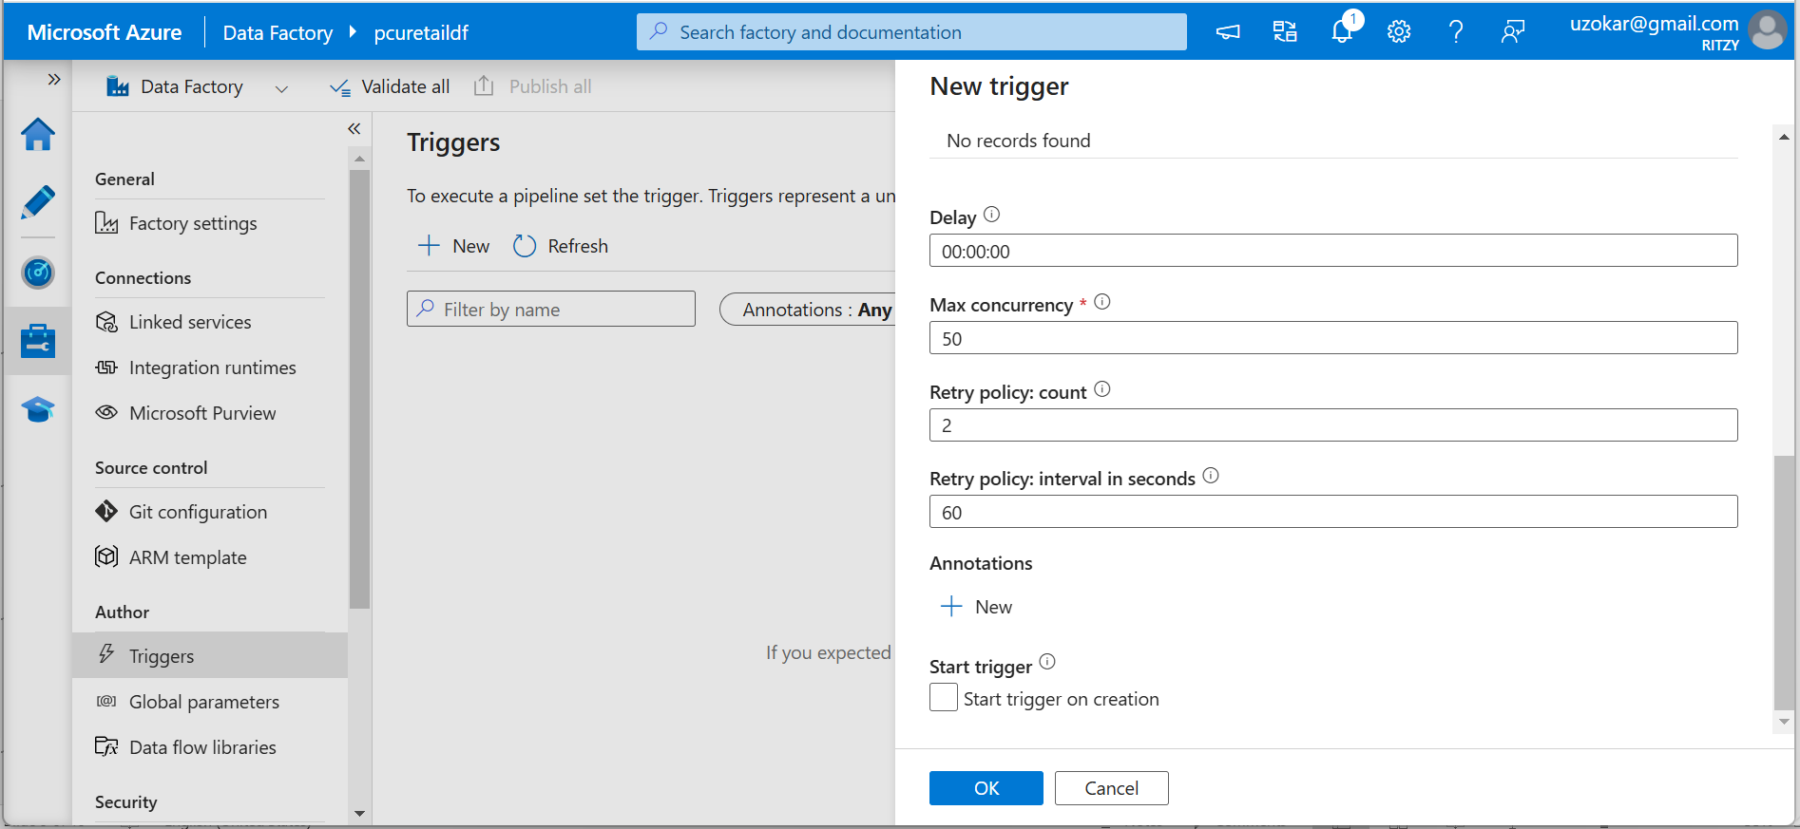
ADF Pipeline: Retry process
.

Slide 13
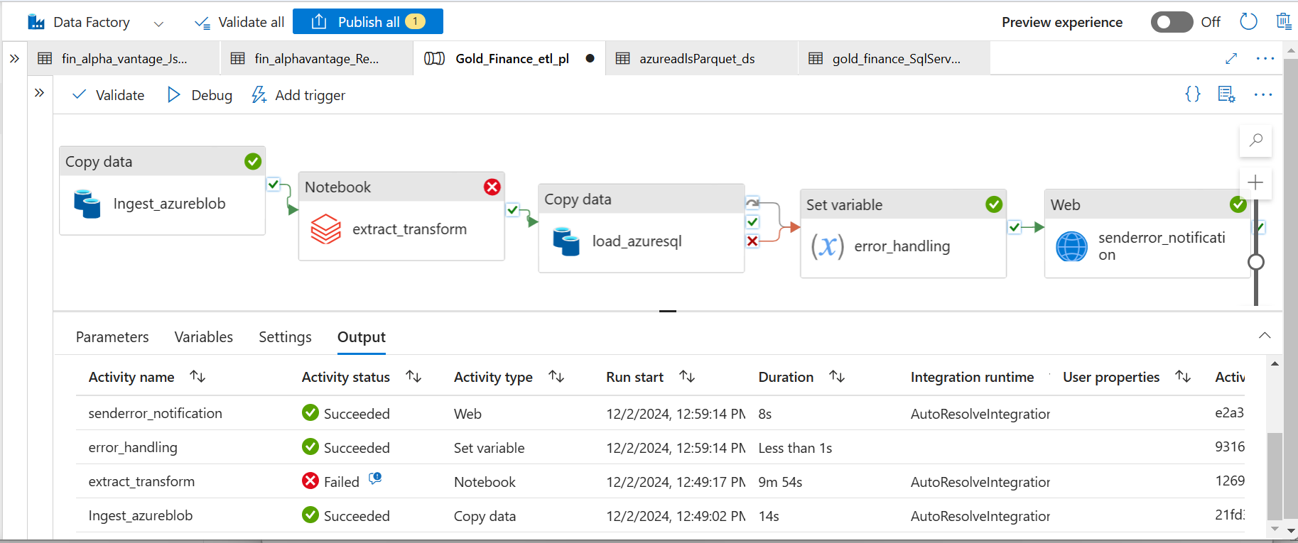
Error Handling and Notification in ADF
.

Slide 14
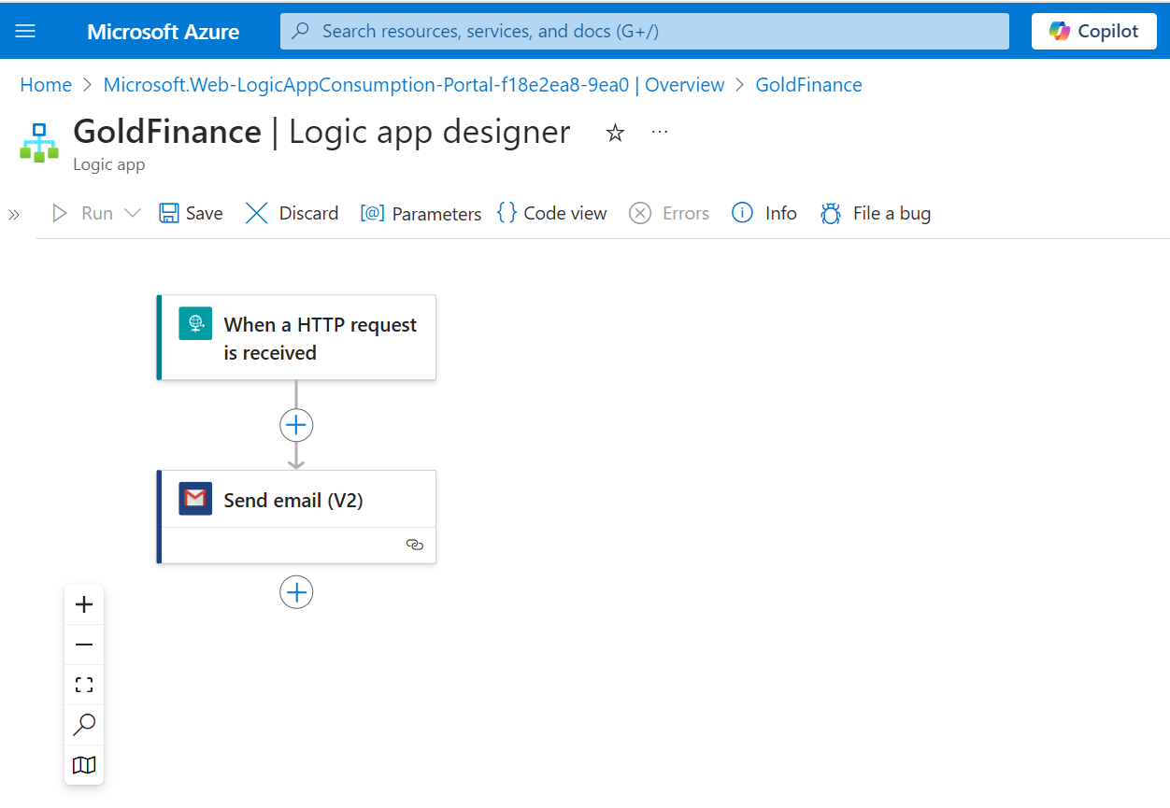
Azure Logic Apps Configuration
.

Slide 15
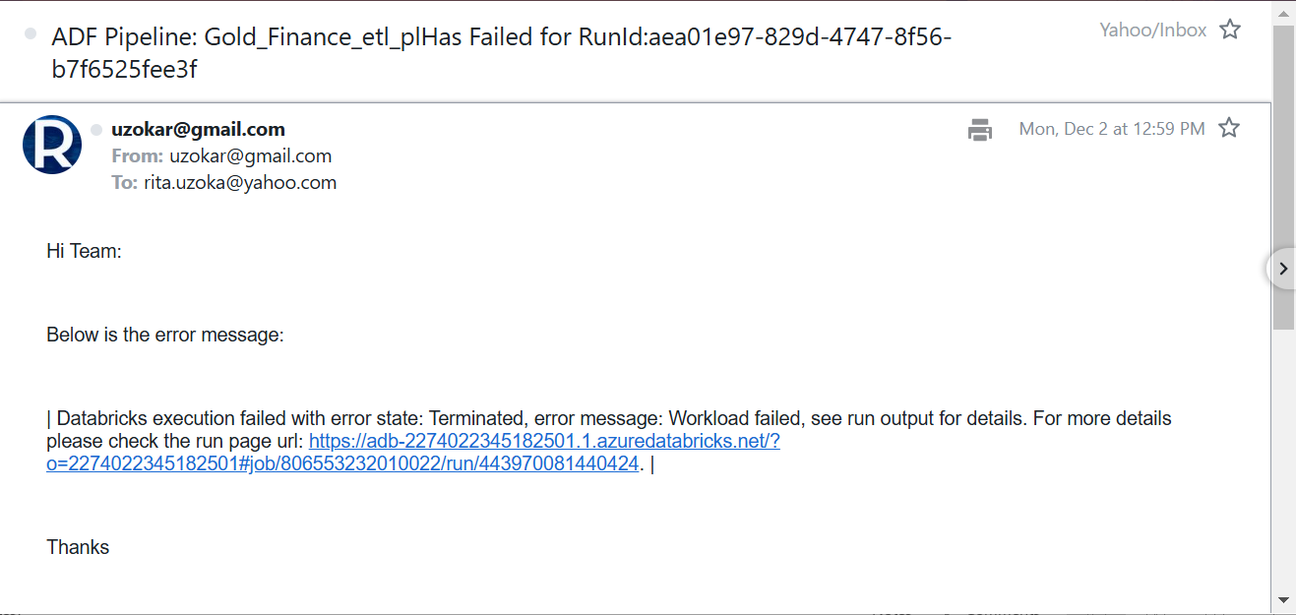
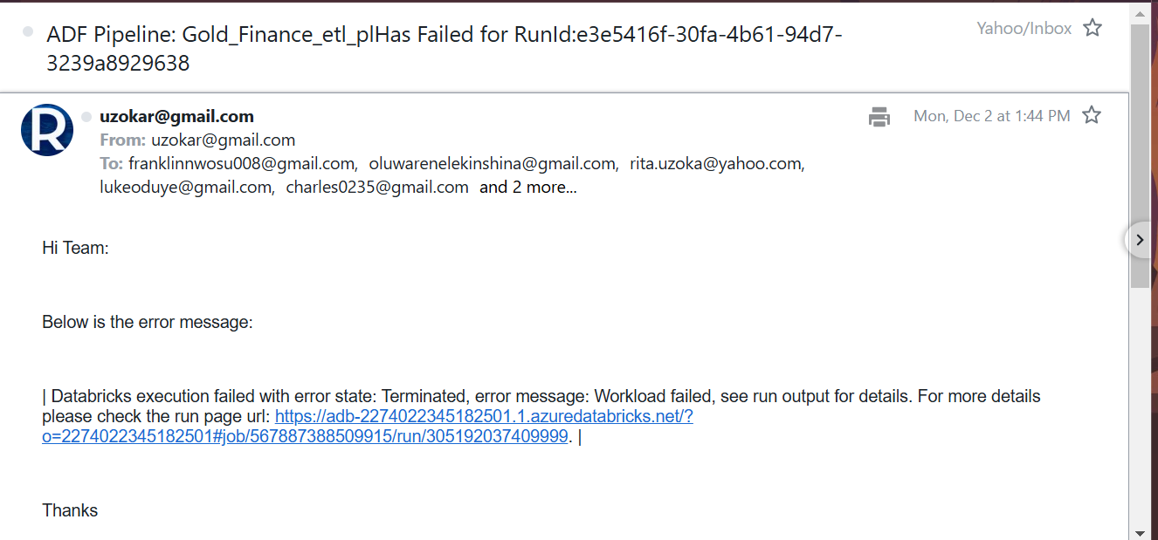
ADF Pipeline Email Alerts
.

Slide 16
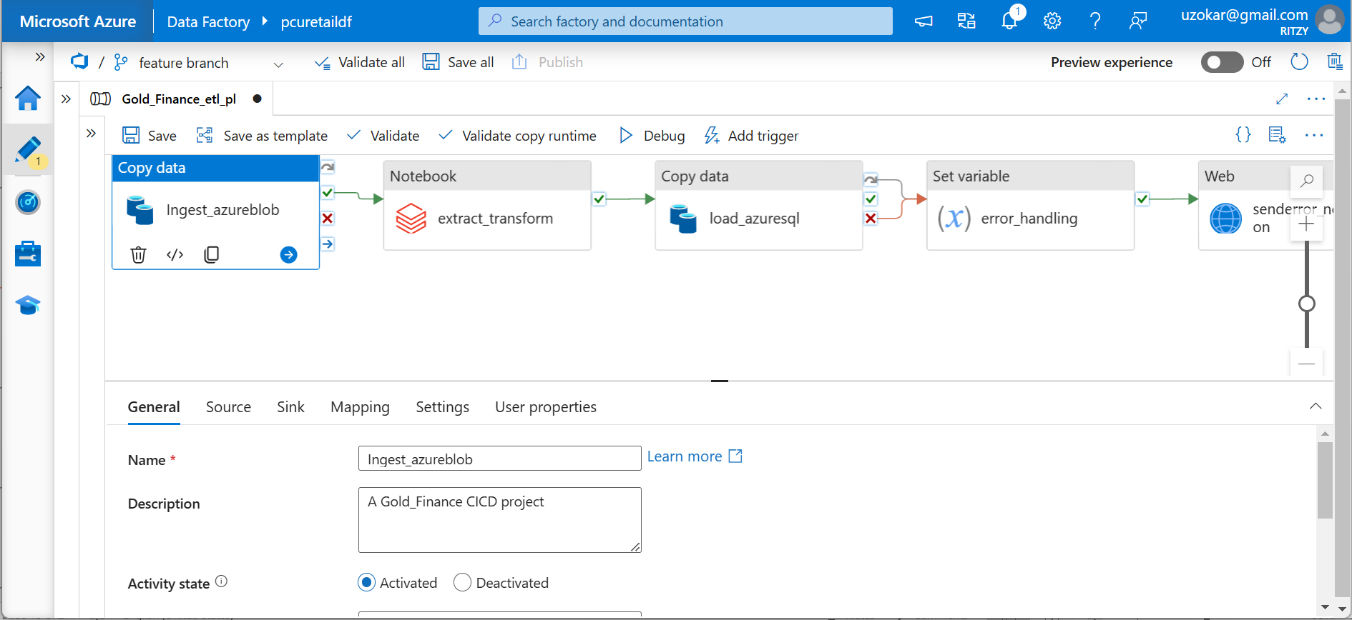
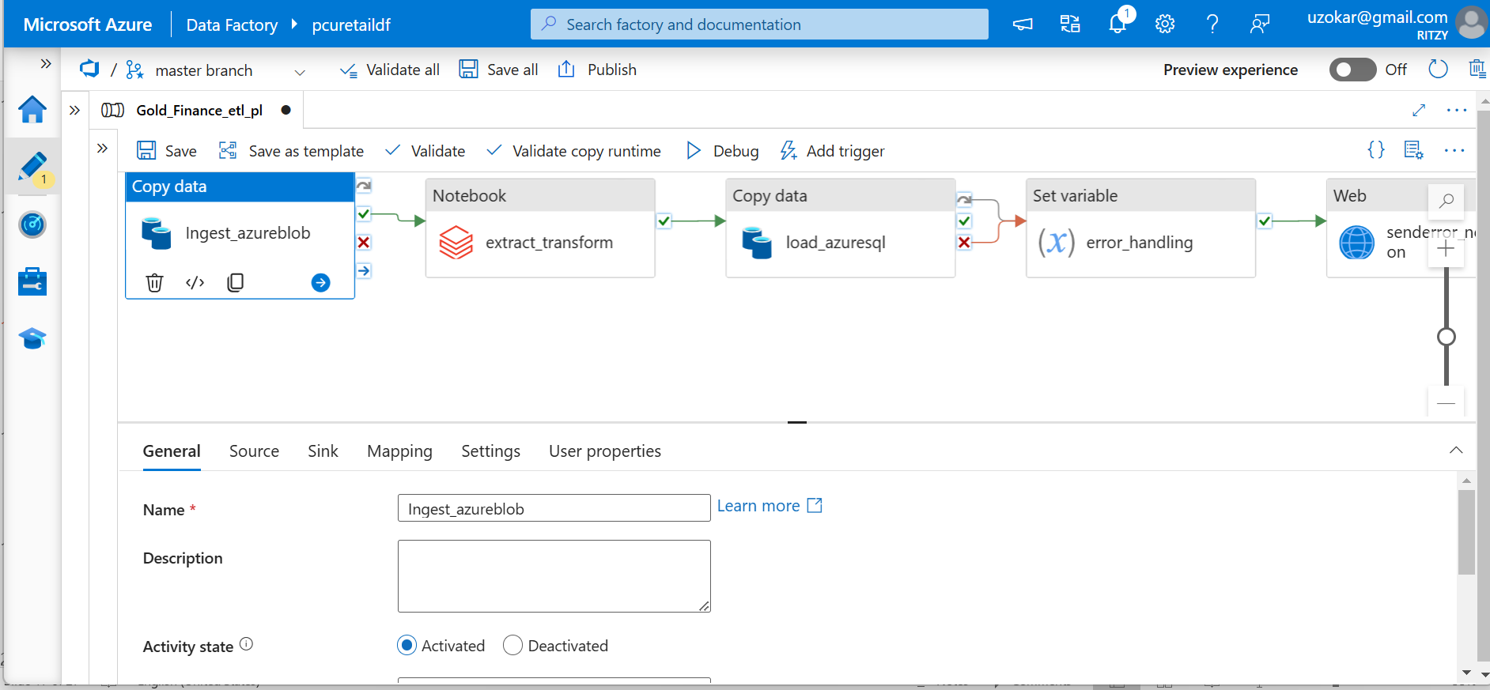
Continuous Integration: Azure Repo Pull Request
.

Slide 17
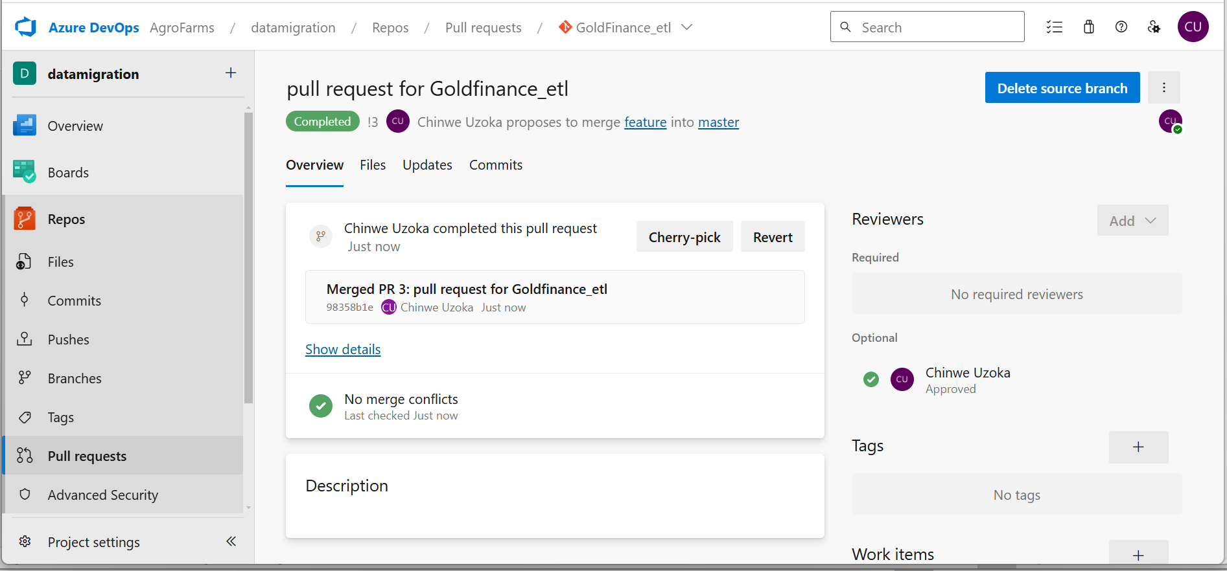

Continuous Integration: Merge Request to
Main Branch
.

Slide 18
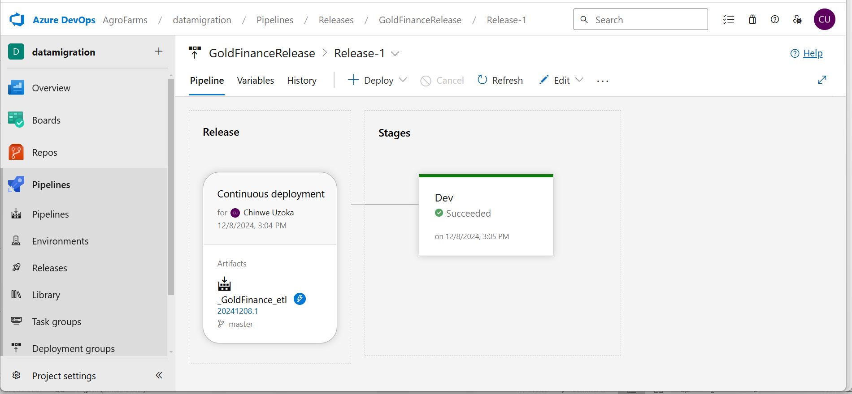
CICD: Deployed to Live Mode
.

Slide 19
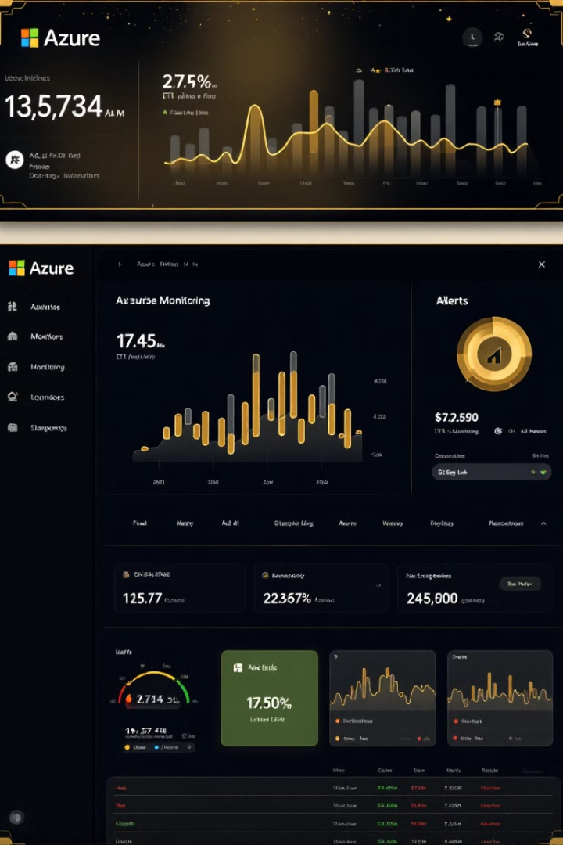
Monitoring and Troubleshooting the ETL Process
Real-time Monitoring
Log Analytics
Track pipeline progress and resource utilization with Azure Monitor.
Analyze detailed logs to identify performance bottlenecks and errors.
Alerting System
Diagnostic Tools
Set up proactive alerts for critical issues and SLA breaches.
Use built-in diagnostic tools to quickly resolve common ETL problems.

Slide 20




Securing the Data and the ETL Workflow
Data Encryption
1
Protect data at rest and in transit.
Access Control
2
Implement role-based access and authentication measures.
Network Security
3
Use virtual networks and firewalls to isolate resources.
Compliance
4
Ensure adherence to financial regulations and data privacy laws.

Slide 21
Challenges Encountered
Setting up azure account
1
Use another email and use a dollar debit card.
Integrating ADF with Databricks
2
This only works for azure databricks.
Mounting Azure storage on Databricks
3
Dbutils fs ls and dbutils fs mounts to verify mounts and file paths.
Integrating azure sql database with databricks and adf
4
Always check azure sql server firewall for Ip address and install sql library in databricks.

Slide 22
Scaling the ETL Solution for Growing Data Volumes
Optimize Code
1
Refine data processing logic for better performance.
Increase Resources
2
Scale up Azure services to handle larger data volumes.
Implement Partitioning
3
Use data partitioning for parallel processing and faster loads.
Consider Data Lake
4
Integrate Azure Data Lake for handling massive unstructured datasets.

Slide 23
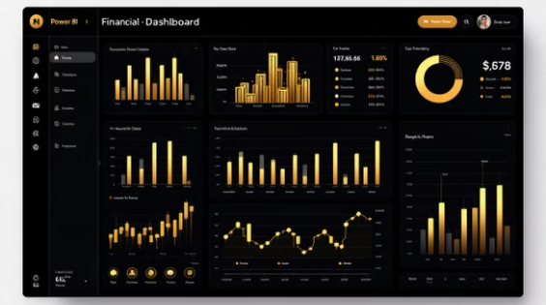



Integrating the ETL with Reporting and Analytics Tools
Seamlessly connect your ETL pipeline output to various reporting and analytics tools for actionable financial insights and decision-making.

Slide 24
Thank You.

